Slide 1
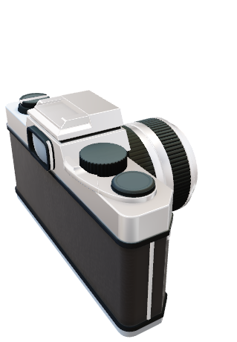
SFF Using 3D window

Slide 3
Green
Blue
Green
Red
Blue
Green
Red
Green
Red
Green
Blue
Green
Green
Red
Green
Blue

Slide 6
(-3, 3)
(-2, 3)
(-1, 3)
(0, 3)
(1, 3)
(2, 3)
(3, 3)
(-3, 2)
(-2, 2)
(-1, 2)
(0, 2)
(1, 2)
(2, 2)
(3, 2)
(-3, 1)
(-2, 1)
(-1, 1)
(0, 1)
(1, 1)
(2, 1)
(3, 1)
(-3, 0)
(-2, 0)
(-1, 0)
(0, 0)
(1, 0)
(2, 0)
(3, 0)
(-3, -1)
(-2, -1)
(-1, -1)
(0, -1)
(1, -1)
(2, -1)
(3, -1)
(-3, -2)
(-2, -2)
(-1, -2)
(0, -2)
(1, -2)
(2, -2)
(3, -2)
(-3, -3)
(-2, -3)
(-1, -3)
(0, -3)
(1, -3)
(2, -3)
(3, -3)

Slide 7
(-3, 3)
(-2, 3)
(-1, 3)
(0, 3)
(1, 3)
(2, 3)
(3, 3)
(-3, 2)
(-2, 2)
(-1, 2)
(0, 2)
(1, 2)
(2, 2)
(3, 2)
(-3, 1)
(-2, 1)
(-1, 1)
(0, 1)
(1, 1)
(2, 1)
(3, 1)
(-3, 0)
(-2, 0)
(-1, 0)
(0, 0)
(1, 0)
(2, 0)
(3, 0)
(-3, -1)
(-2, -1)
(-1, -1)
(0, -1)
(1, -1)
(2, -1)
(3, -1)
(-3, -2)
(-2, -2)
(-1, -2)
(0, -2)
(1, -2)
(2, -2)
(3, -2)
(-3, -3)
(-2, -3)
(-1, -3)
(0, -3)
(1, -3)
(2, -3)
(3, -3)

Slide 8
.lfr データ
多視点画像
多焦点画像
特徴量記述：FAST
Focus値計算：3D Laplacian
マッチング
デプス推定、コスト計算
B = (focus値を標準化？)
三次元位置推定、コスト計算
コスト最小化問題
min. A + αB
全画素のz
A = fL - fR
デプスマップ

